Slide 1




DevOps In Action
Dave Strebel
Cloud Technical Specialist
Microsoft
@HybridCloud_Guy
About Me:
Mixture of infrastructure and dev
Love technology and beer
Open Source Fan, Microsoft Lover
Docker\CF Meetup Organizer
blogs.technet.com/hybridguy

Slide 2

@HybridCloud_Guy

Slide 3

It’s DevOps!
It’s DevOps!
It’s DevOps!
It’s DevOps!
@HybridCloud_Guy

Slide 4
“DevOps is the union of people, process, and products to enable continuous delivery of value to our end users.”
Donovan Brown
http://bit.ly/WhatIs-DevOps
@HybridCloud_Guy

Slide 5
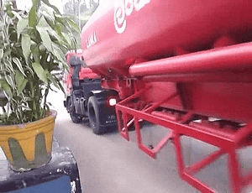
The Plan: Flawless Execution
http://devopsreactions.tumblr.com
@HybridCloud_Guy

Slide 6

The Reality: Environments differ
http://devopsreactions.tumblr.com
@HybridCloud_Guy

Slide 7

A Partial Solution: The Right Tools
http://devopsreactions.tumblr.com
@HybridCloud_Guy

Slide 8

A Partial Solution: The Right Tools
http://devopsreactions.tumblr.com
@HybridCloud_Guy

Slide 9
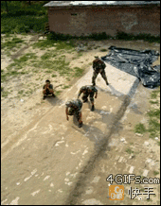
A Partial Solution: Team
http://devopsreactions.tumblr.com
@HybridCloud_Guy

Slide 10

A Partial Solution: Team
http://devopsreactions.tumblr.com
@HybridCloud_Guy

Slide 11



The Issue
Dev
Ops

Slide 12

Communication

Slide 13

Culture

Slide 14
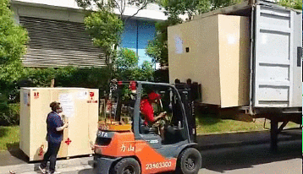
Full Solution: Tools, Team and Process
http://devopsreactions.tumblr.com
@HybridCloud_Guy

Slide 15
Tools

Slide 16


Infrastructure & Configuration as Code
DEV
Value
Optimized Resources
Accelerate Delivery
CODE
STAGE
Measure
Deployment Rate
MTTR
PRODUCTION
DEV
OPS
@HybridCloud_Guy

Slide 17

Continuous Integration
Source
Build
Value
Accelerate Delivery
Repeatability
Optimized Resources
Test
Measure
More frequent releases
MTTR
MTTD
DEV
OPS
OPS
@HybridCloud_Guy

Slide 18
Continuous Delivery
SOURCE REPO
DEV
Value
Optimized Resources
Accelerate Delivery
STAGE
Measure
Deployment Rate
MTTR
Availability
PRODUCTION
DEV
OPS
@HybridCloud_Guy

Slide 19
DevOps Tools
Build | Provisioning | Release Management | Configuration | Monitoring & Diagnostics
GitHub Jenkins Cloudbees Teamcity Bamboo | PowerShell Azure CLI (xplat-cli) ARM templates Chef Knife Puppet CLI Vagrant Deis Ansible | Visual Studio RM Octopus Deploy Dev/Test Labs | Chef DSC Extension Puppet Labs Salt Ansible | Application Insights OpInsights New Relic Nagios DataDog Azure Monitoring
@HybridCloud_Guy

Slide 20

Demo Time

